Slide 1
Computational Geometry
Misha Kazhdan

Slide 2
Outline
Algorithmic complexity
Convex hull
Duality
Upper envelopes and lower hulls

Slide 3
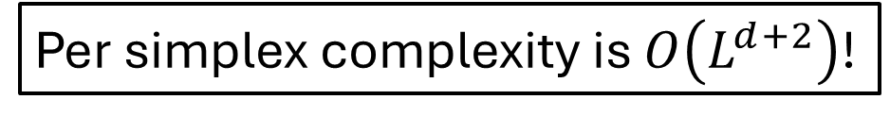

Multi-label segmentation
Per-simplex algorithm:
For each (d+1)-tuple $1≤i_{0}<⋯<i_{d}≤L$
Compute the point $p$ s.t. $f_{i_{0}}\left(p\right)=⋯=f_{i_{d}}(p)$
If $p$ is in the simplex and $f_{i_{0}}\left(p\right)=⋯=f_{i_{d}}(p)=\max_{1≤l≤L}{f_{l}(p)}$
Add $p$ to the vertex list
Per simplex complexity is $O\left(L^{d+2}\right)$!

Slide 4












Multi-label segmentation ($d=1$)
Given an edge on the real line
Consider the graphs of the affine functions
Our goal is to find the positions where:
Two functions are equal $⇔$ their graphs intersect
The two functions dominate $⇔$ the point of intersection is above the other graphs
Our implementation does this by:
Trying all intersections
Testing if they dominate
$$f_{1}$$
$$f_{3}$$
$$f_{2}$$
$$f_{6}$$
$$f_{5}$$
$$f_{4}$$
$$f_{4}$$
$$f_{6}$$
$$f_{3}$$
$$f_{1}$$

Slide 5


Convex hull
Definition:
A region $ℛ⊂ℝ^{d}$ is said to be convex if it is the intersection of (closed) half-spaces.
$$ℛ$$

Slide 6

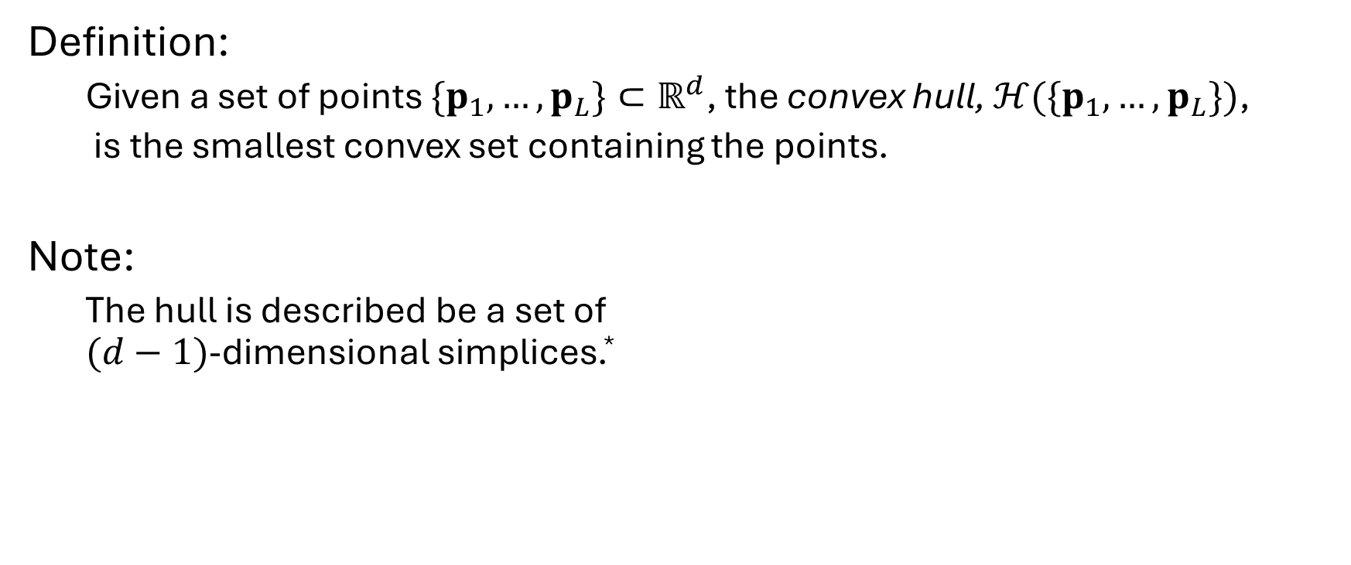
Convex hull
Definition:
Given a set of points $\{p_{1},…,p_{L}\}⊂ℝ^{d}$, the convex hull, $ℋ({\{p}_{1},…,p_{L}\})$,
is the smallest convex set containing the points.
Note:
The hull is described be a set of $(d−1)$-dimensional simplices.*
$$ℋ({\{p}_{1},…,p_{L}\})$$
*Throughout will be assuming that geometry is “in general position”

Slide 7
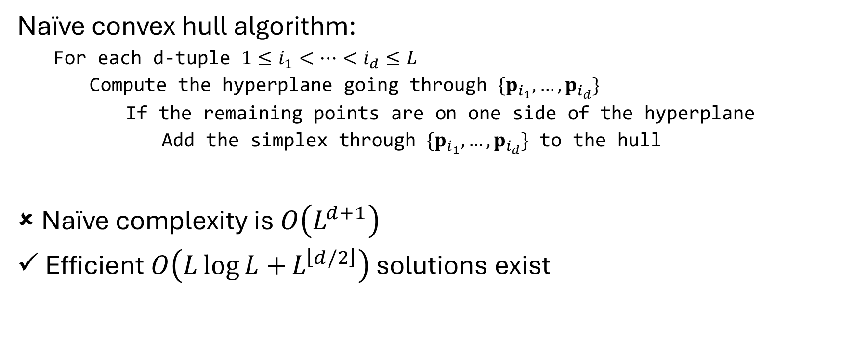
Convex hull
Naïve convex hull algorithm:
For each d-tuple $1≤i_{1}<⋯<i_{d}≤L$
Compute the hyperplane going through $\{p_{i_{1}},…,p_{i_{d}}\}$
If the remaining points are on one side of the hyperplane
Add the simplex through $\{p_{i_{1}},…,p_{i_{d}}\}$ to the hull
Naïve complexity is $O\left(L^{d+1}\right)$
Efficient $O\left(L\log{L+}L^{\left\lfloor d/2\right\rfloor }\right)$ solutions exist
[Graham, 1972; Preparata et al., 1973; Seidel, 1981; Chazelle, 1993]
http://www.qhull.org/

Slide 8
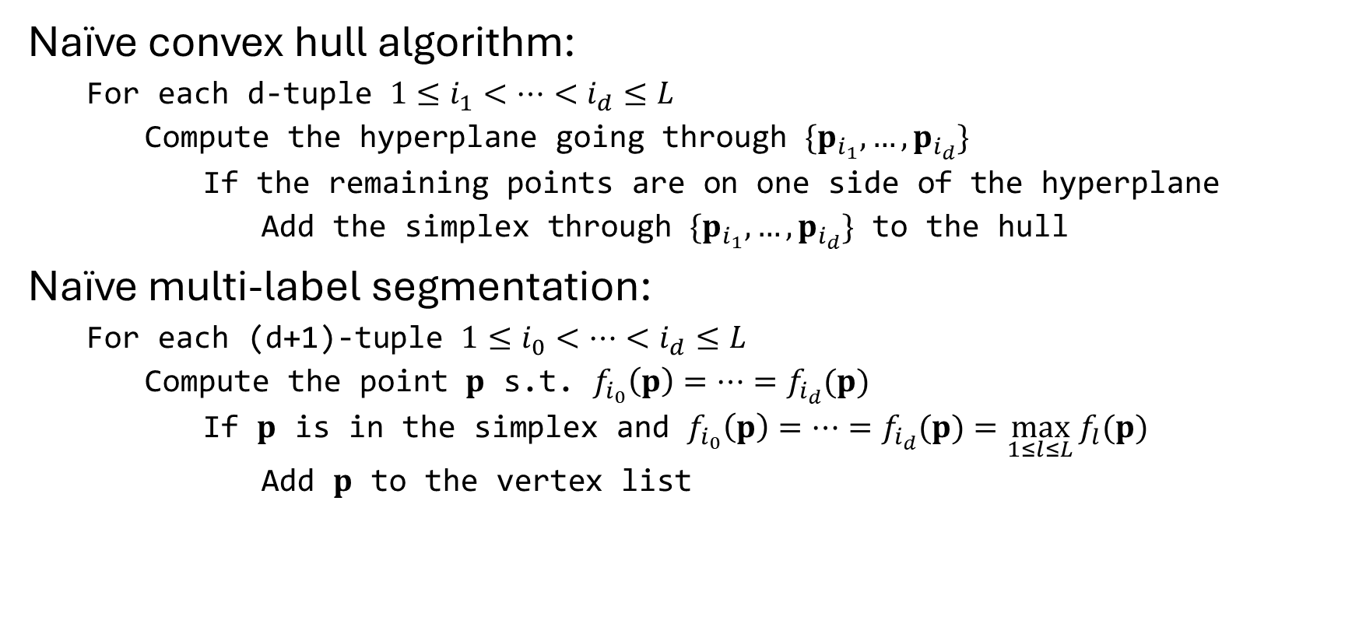
Convex hull vs multi-label segmentation
Naïve convex hull algorithm:
For each d-tuple $1≤i_{1}<⋯<i_{d}≤L$
Compute the hyperplane going through $\{p_{i_{1}},…,p_{i_{d}}\}$
If the remaining points are on one side of the hyperplane
Add the simplex through $\{p_{i_{1}},…,p_{i_{d}}\}$ to the hull
Naïve multi-label segmentation:
For each (d+1)-tuple $1≤i_{0}<⋯<i_{d}≤L$
Compute the point $p$ s.t. $f_{i_{0}}\left(p\right)=⋯=f_{i_{d}}(p)$
If $p$ is in the simplex and $f_{i_{0}}\left(p\right)=⋯=f_{i_{d}}(p)=\max_{1≤l≤L}{f_{l}(p)}$
Add $p$ to the vertex list
Goal: Formulate multi-label segmentation as a convex hull problem and leverage efficient algorithms

Slide 9
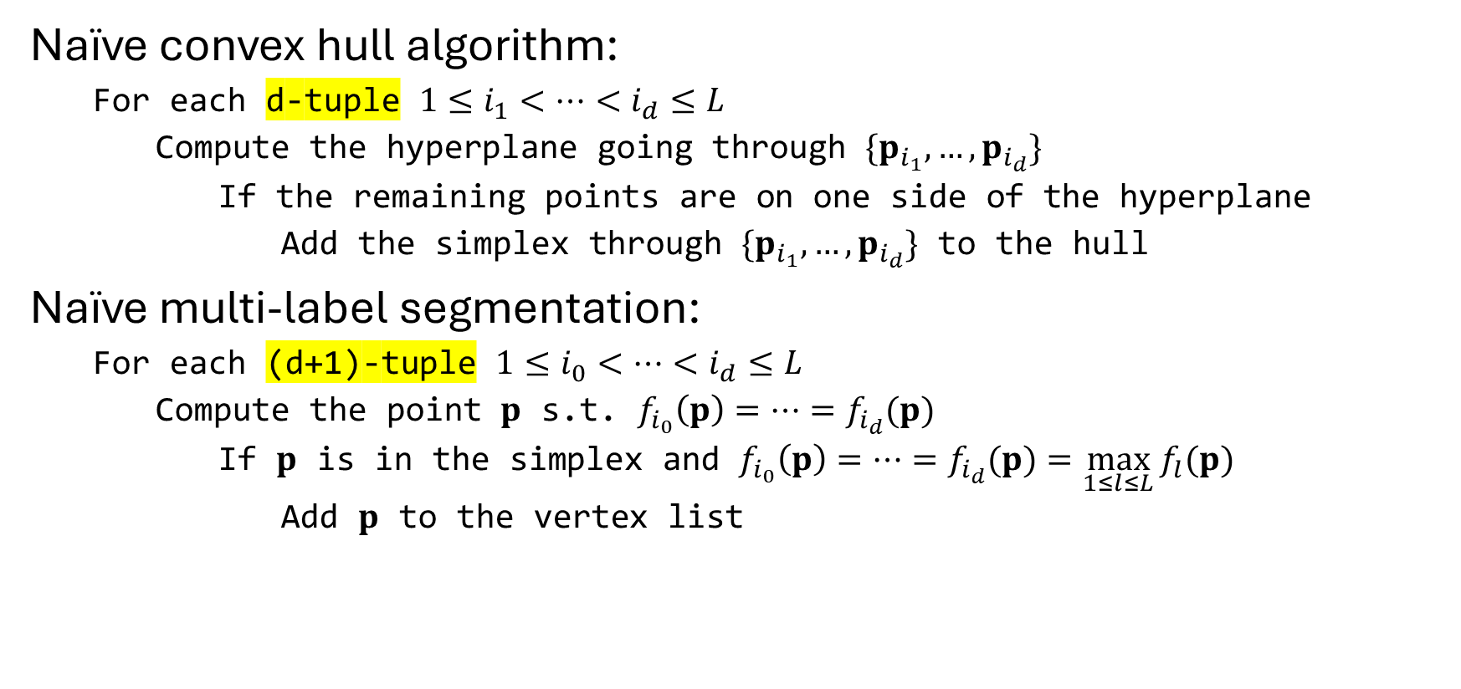
Convex hull vs multi-label segmentation
Naïve convex hull algorithm:
For each d-tuple $1≤i_{1}<⋯<i_{d}≤L$
Compute the hyperplane going through $\{p_{i_{1}},…,p_{i_{d}}\}$
If the remaining points are on one side of the hyperplane
Add the simplex through $\{p_{i_{1}},…,p_{i_{d}}\}$ to the hull
Naïve multi-label segmentation:
For each (d+1)-tuple $1≤i_{0}<⋯<i_{d}≤L$
Compute the point $p$ s.t. $f_{i_{0}}\left(p\right)=⋯=f_{i_{d}}(p)$
If $p$ is in the simplex and $f_{i_{0}}\left(p\right)=⋯=f_{i_{d}}(p)=\max_{1≤l≤L}{f_{l}(p)}$
Add $p$ to the vertex list
Goal: Formulate multi-label segmentation as a convex hull problem and leverage efficient algorithms

Slide 10
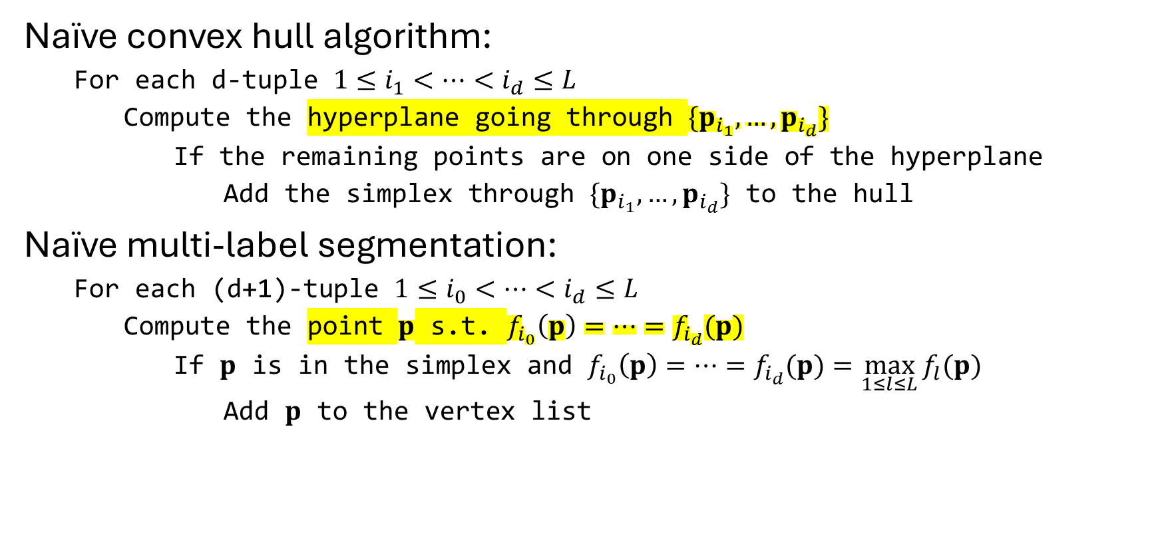
Convex hull vs multi-label segmentation
Naïve convex hull algorithm:
For each d-tuple $1≤i_{1}<⋯<i_{d}≤L$
Compute the hyperplane going through $\{p_{i_{1}},…,p_{i_{d}}\}$
If the remaining points are on one side of the hyperplane
Add the simplex through $\{p_{i_{1}},…,p_{i_{d}}\}$ to the hull
Naïve multi-label segmentation:
For each (d+1)-tuple $1≤i_{0}<⋯<i_{d}≤L$
Compute the point $p$ s.t. $f_{i_{0}}\left(p\right)=⋯=f_{i_{d}}(p)$
If $p$ is in the simplex and $f_{i_{0}}\left(p\right)=⋯=f_{i_{d}}(p)=\max_{1≤l≤L}{f_{l}(p)}$
Add $p$ to the vertex list
Goal: Formulate multi-label segmentation as a convex hull problem and leverage efficient algorithms

Slide 11
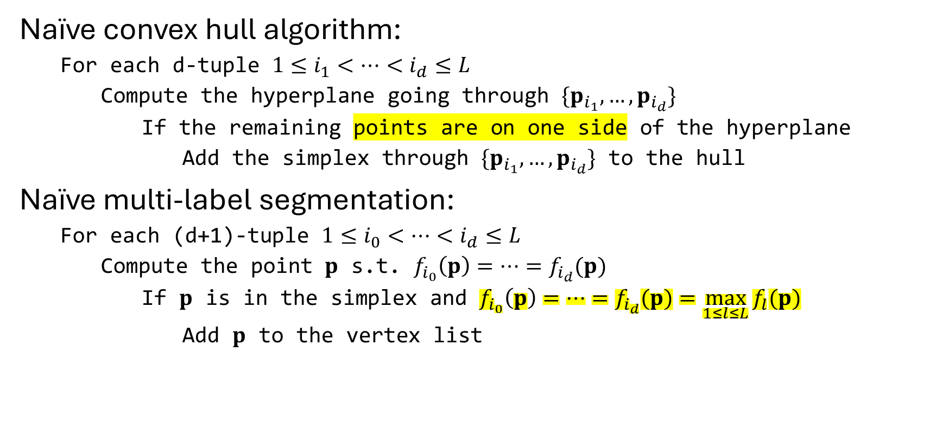
Convex hull vs multi-label segmentation
Naïve convex hull algorithm:
For each d-tuple $1≤i_{1}<⋯<i_{d}≤L$
Compute the hyperplane going through $\{p_{i_{1}},…,p_{i_{d}}\}$
If the remaining points are on one side of the hyperplane
Add the simplex through $\{p_{i_{1}},…,p_{i_{d}}\}$ to the hull
Naïve multi-label segmentation:
For each (d+1)-tuple $1≤i_{0}<⋯<i_{d}≤L$
Compute the point $p$ s.t. $f_{i_{0}}\left(p\right)=⋯=f_{i_{d}}(p)$
If $p$ is in the simplex and $f_{i_{0}}\left(p\right)=⋯=f_{i_{d}}(p)=\max_{1≤l≤L}{f_{l}(p)}$
Add $p$ to the vertex list
Goal: Formulate multi-label segmentation as a convex hull problem and leverage efficient algorithms

Slide 12
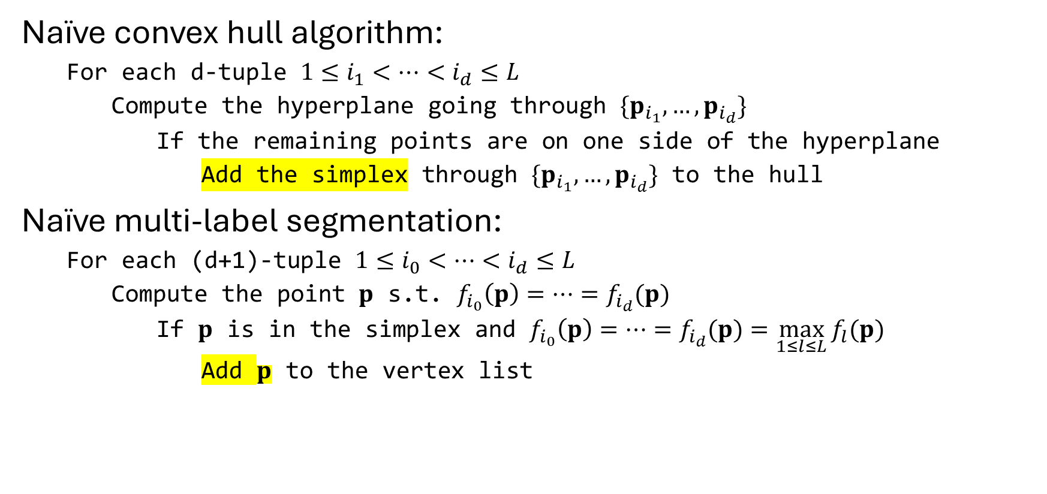
Convex hull vs multi-label segmentation
Naïve convex hull algorithm:
For each d-tuple $1≤i_{1}<⋯<i_{d}≤L$
Compute the hyperplane going through $\{p_{i_{1}},…,p_{i_{d}}\}$
If the remaining points are on one side of the hyperplane
Add the simplex through $\{p_{i_{1}},…,p_{i_{d}}\}$ to the hull
Naïve multi-label segmentation:
For each (d+1)-tuple $1≤i_{0}<⋯<i_{d}≤L$
Compute the point $p$ s.t. $f_{i_{0}}\left(p\right)=⋯=f_{i_{d}}(p)$
If $p$ is in the simplex and $f_{i_{0}}\left(p\right)=⋯=f_{i_{d}}(p)=\max_{1≤l≤L}{f_{l}(p)}$
Add $p$ to the vertex list
Goal: Formulate multi-label segmentation as a convex hull problem and leverage efficient algorithms

Slide 13
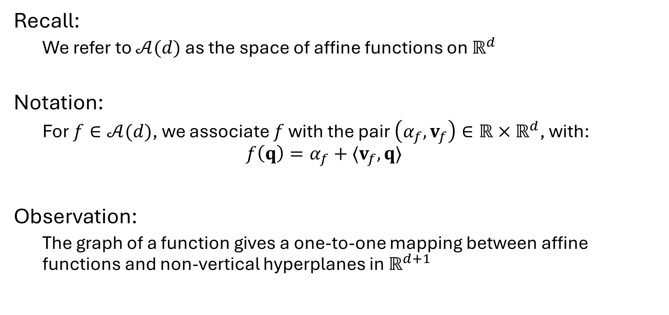
Affine functions
Recall:
We refer to $𝒜(d)$ as the space of affine functions on $ℝ^{d}$
Notation:
For $f∈𝒜(d)$, we associate $f$ with the pair $\left(α_{f},v_{f}\right)∈ℝ×ℝ^{d}$, with: $$f\left(q\right)=α_{f}+⟨v_{f},q⟩$$
Observation:
The graph of a function gives a one-to-one mapping between affine functions and non-vertical hyperplanes in $ℝ^{d+1}$

Slide 14




Affine functions
Recall:
We refer to $𝒜(d)$ as the space of affine functions on $ℝ^{d}$
Notation:
For $f∈𝒜(d)$, we associate $f$ with the pair $\left(α_{f},v_{f}\right)∈ℝ×ℝ^{d}$, with: $$f\left(x\right)=α_{f}+⟨v_{f},x⟩$$
Observation:
The graph of a function gives a one-to-one mapping between affine functions and non-vertical hyperplanes in $ℝ^{d+1}$
$$x_{0}$$
$$f$$
$${(x}_{1},…,x_{d})$$

Slide 15
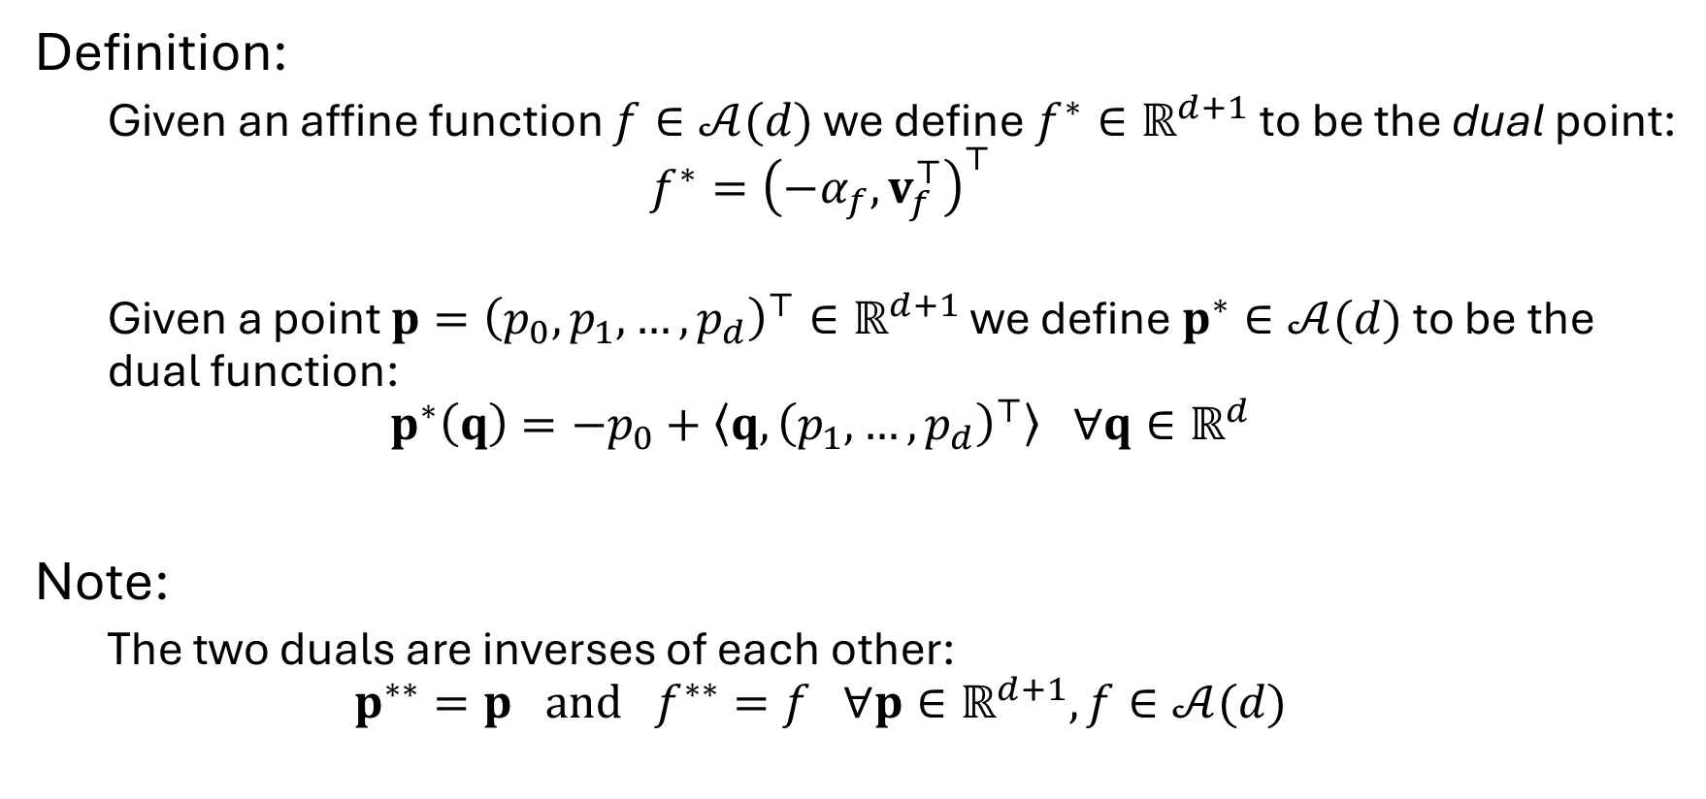
Duality
Definition:
Given an affine function $f∈𝒜(d)$ we define $f^{∗}∈ℝ^{d+1}$ to be the dual point: $$f^{∗}={\left(−α_{f},v_{f}^{⊤}\right)}^{⊤}$$
Given a point $p={\left(p_{0},p_{1},…,p_{d}\right)}^{⊤}∈ℝ^{d+1}$ we define $p^{∗}∈𝒜(d)$ to be the dual function: $$p^{∗}\left(q\right)=−p_{0}+\left\langle q,{\left(p_{1},…, p_{d}\right)}^{⊤}\right\rangle ∀q∈ℝ^{d}$$
Note:
The two duals are inverses of each other: $$p^{∗∗}=p and f^{∗∗}=f ∀p∈ℝ^{d+1},f∈𝒜(d)$$

Slide 16



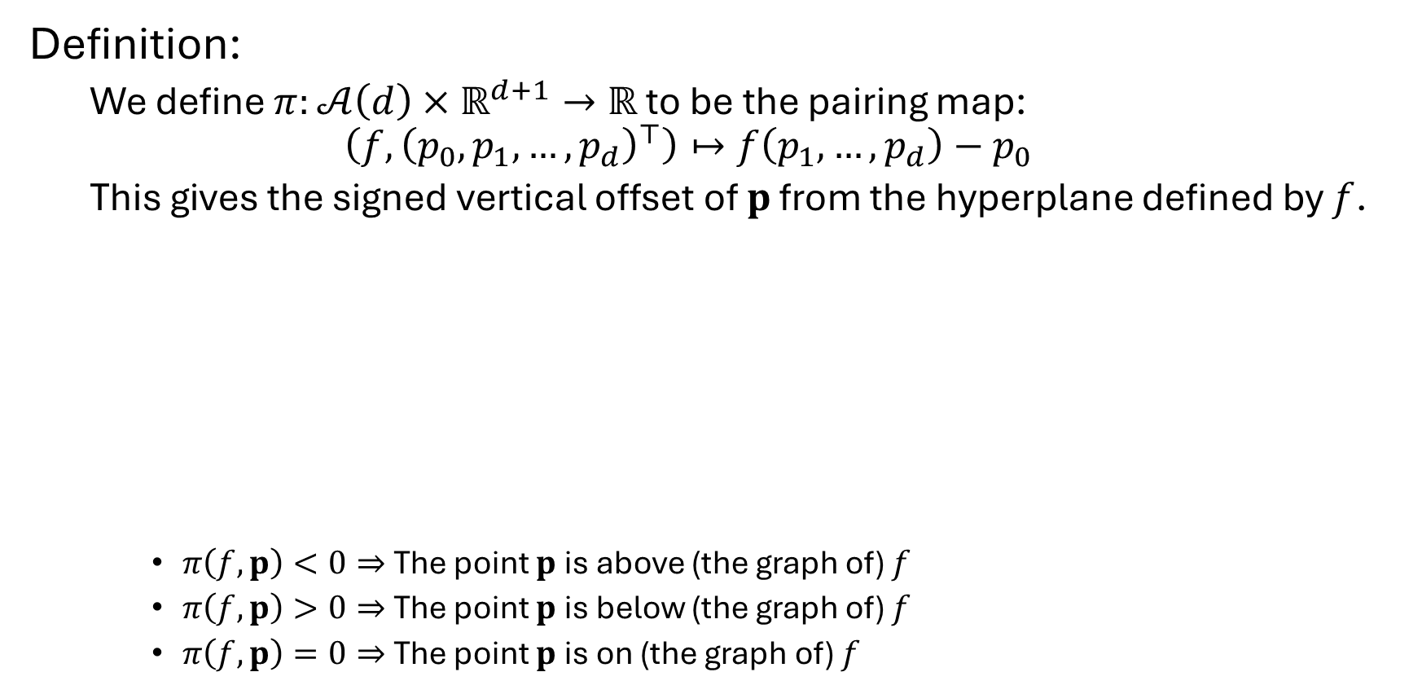



Pairing
Definition:
We define $π:𝒜\left(d\right)×ℝ^{d+1}→ℝ$ to be the pairing map: $$\left(f,{\left(p_{0},p_{1},…, p_{d}\right)}^{⊤}\right)↦f\left(p_{1},…,p_{d}\right)−p_{0}$$
This gives the signed vertical offset of $p$ from the hyperplane defined by $f$.
$π\left(f,p\right)<0⇒$ The point $p$ is above (the graph of) $f$
$π\left(f,p\right)>0⇒$ The point $p$ is below (the graph of) $f$
$π\left(f,p\right)=0⇒$ The point $p$ is on (the graph of) $f$
$$p$$
$$f$$
$$p_{0}$$
$π(f,p$)
$${f(p}_{1},…,p_{d})$$
$$(p_{1},…,p_{d})$$

Slide 17
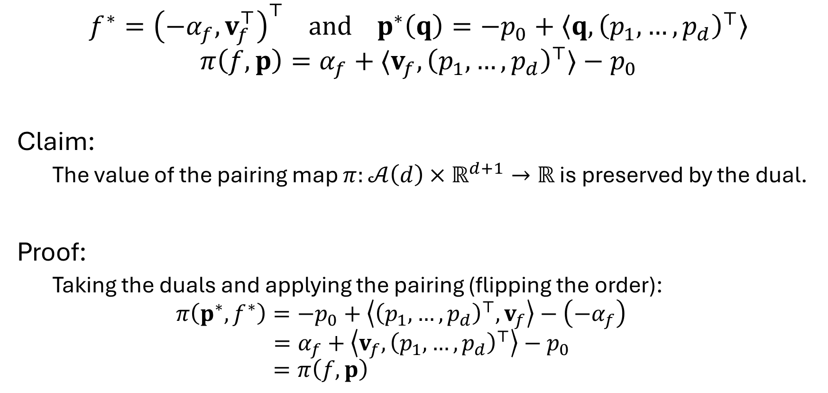
Pairing
$$f^{∗}={\left(−α_{f},v_{f}^{⊤}\right)}^{⊤} and p^{∗}\left(q\right)=−p_{0}+\left\langle q,{\left(p_{1},…, p_{d}\right)}^{⊤}\right\rangle$$
$$π\left(f,p\right)=α_{f}+⟨v_{f},{\left(p_{1},…,p_{d}\right)}^{⊤}⟩−p_{0}$$
Claim:
The value of the pairing map $π:𝒜\left(d\right)×ℝ^{d+1}→ℝ$ is preserved by the dual.
Proof:
Taking the duals and applying the pairing (flipping the order): $$π\left(p^{∗},f^{∗}\right)=−p_{0}+\left\langle {\left(p_{1},…,p_{d}\right)}^{⊤},v_{f}\right\rangle −\left(−α_{f}\right)$$
$$=α_{f}+\left\langle {v_{f},\left(p_{1},…,p_{d}\right)}^{⊤}\right\rangle −p_{0}$$
$$=π\left(f,p\right)$$

Slide 18
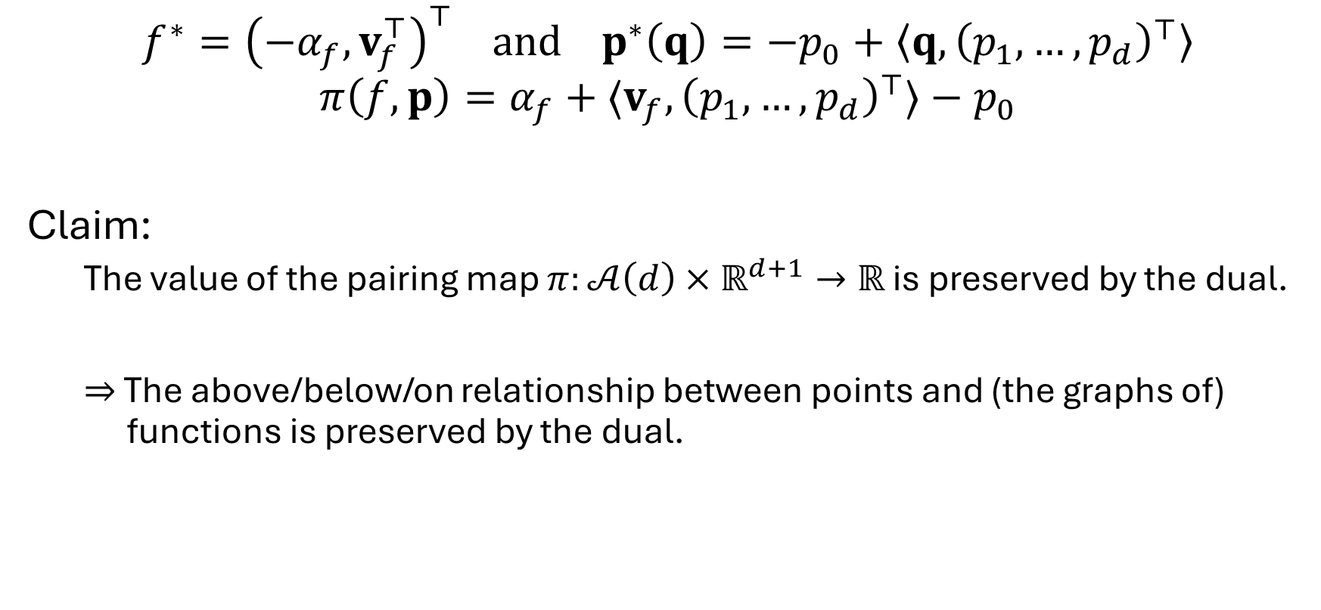
Pairing
$$f^{∗}={\left(−α_{f},v_{f}^{⊤}\right)}^{⊤} and p^{∗}\left(q\right)=−p_{0}+\left\langle q,{\left(p_{1},…, p_{d}\right)}^{⊤}\right\rangle$$
$$π\left(f,p\right)=α_{f}+⟨v_{f},{\left(p_{1},…,p_{d}\right)}^{⊤}⟩−p_{0}$$
Claim:
The value of the pairing map $π:𝒜\left(d\right)×ℝ^{d+1}→ℝ$ is preserved by the dual.
$⇒$ The above/below/on relationship between points and (the graphs of) functions is preserved by the dual.

Slide 19



Upper envelope and lower hull
Definition:
Given affine functions, $\left\{f_{1},…, f_{L}\right\}⊂𝒜(d)$, their upper envelope is the set of points in $ℝ^{d+1}$ corresponding to the maxima of the functions: $$\left\{{\left(p_{0},p_{1},…,p_{d}\right)}^{⊤}∈ℝ^{d+1} | p_{0}=\max_{1≤l≤L}{f_{l}\left(p_{1},…, p_{d}\right)}\right\}$$
$$x_{0}$$
$$f_{1}$$
$$f_{3}$$
$$f_{2}$$
$$f_{6}$$
$$f_{5}$$
$$f_{4}$$
$${(x}_{1},…,x_{d})$$

Slide 20
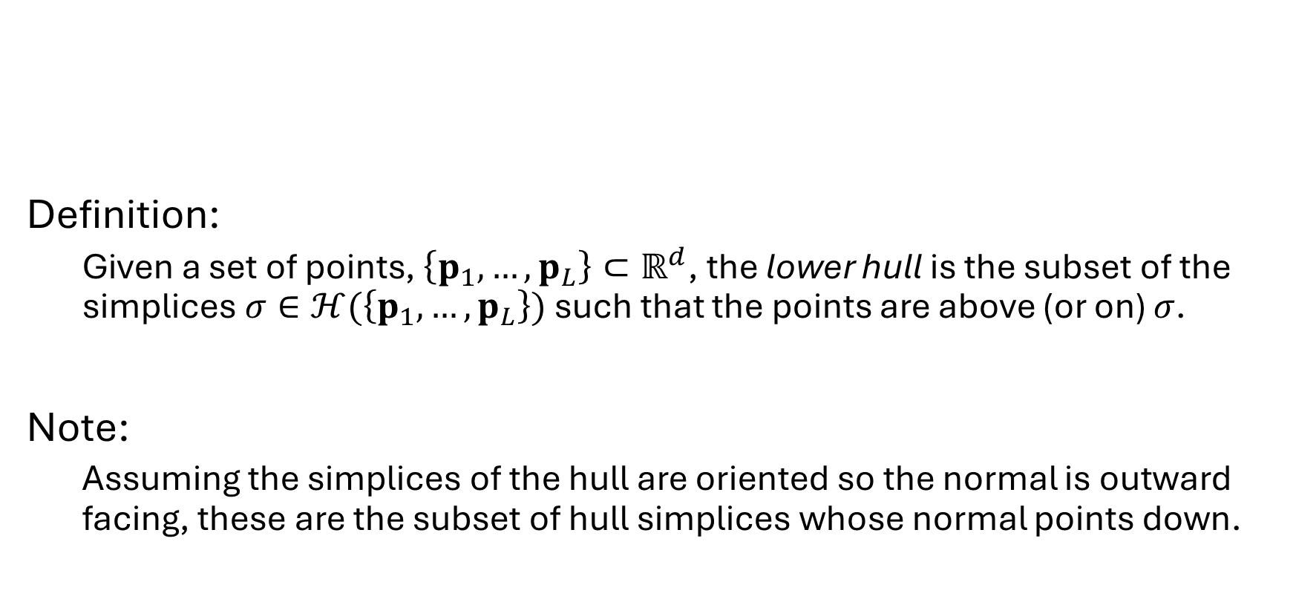
Upper envelope and lower hull
Definition:
Given a set of points, $\left\{p_{1},…, p_{L}\right\}⊂ℝ^{d}$, the lower hull is the subset of the simplices $σ∈ℋ(\left\{p_{1},…, p_{L}\right\})$ such that the points are above (or on) $σ$.
Note:
Assuming the simplices of the hull are oriented so the normal is outward facing, these are the subset of hull simplices whose normal points down.

Slide 21


Upper envelope $↔$ lower hull
Claim:
Given affine functions $\left\{f_{1},…, f_{L}\right\}⊂𝒜\left(d\right)$the vertices of the upper envelope of $\left\{f_{1},…, f_{L}\right\}$ are in one-to-one correspondence with the simplices of the lower hull of the function duals $\left\{f_{1}^{∗},…, f_{L}^{∗}\right\}⊂ℝ^{d+1}$.
$$x_{0}$$
$$f_{1}$$
$$f_{3}$$
$$f_{2}$$
$$f_{6}$$
$$f_{5}$$
$$f_{4}$$
$${(x}_{1},…,x_{d})$$

Slide 22
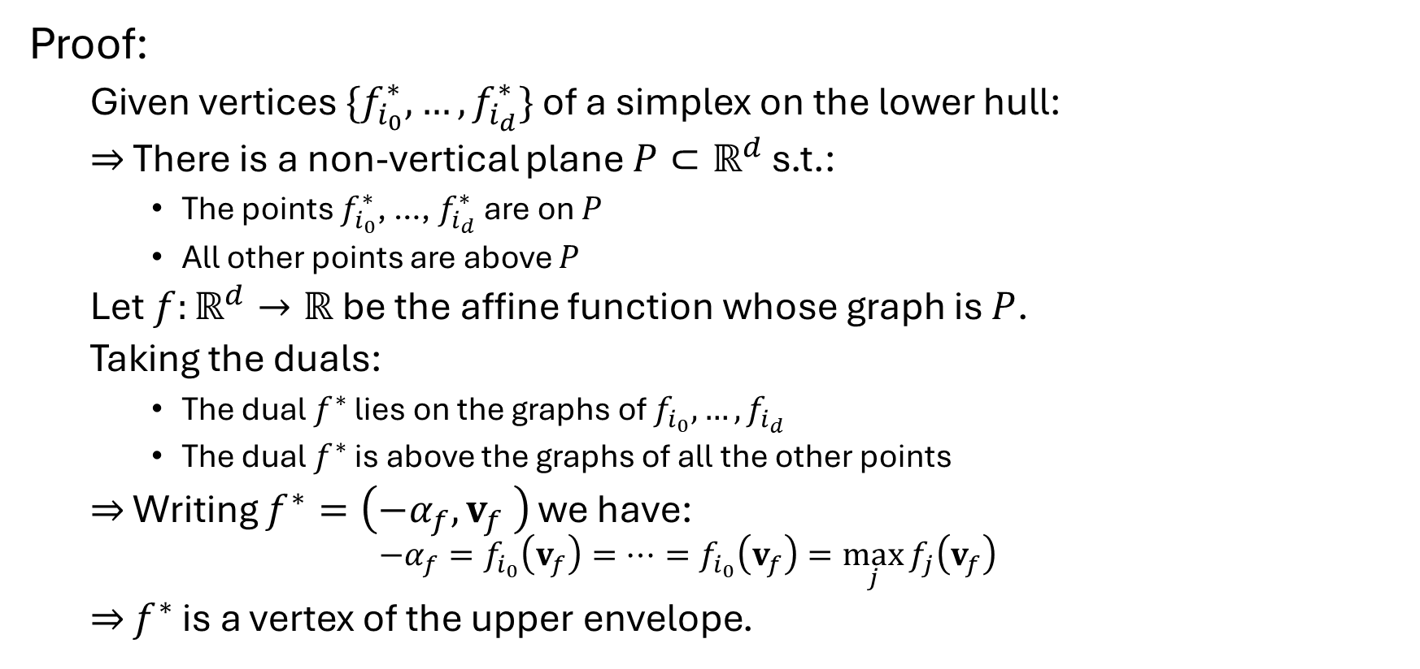

Upper envelope $←$ lower hull
Proof:
Given vertices $\{f_{i_{0}}^{∗},…,f_{i_{d}}^{∗}\}$ of a simplex on the lower hull:
$⇒$ There is a non-vertical plane $P⊂ℝ^{d}$ s.t.:
The points $f_{i_{0}}^{∗}$, …, $f_{i_{d}}^{∗}$ are on $P$
All other points are above $P$
Let $f:ℝ^{d}→ℝ$ be the affine function whose graph is $P$.
Taking the duals:
The dual $f^{∗}$ lies on the graphs of $f_{i_{0}},…,f_{i_{d}}$
The dual $f^{∗}$ is above the graphs of all the other points
$⇒$ Writing $f^{∗}=\left(−α_{f},v_{f} \right)$ we have: $$−α_{f}=f_{i_{0}}\left(v_{f}\right)=⋯=f_{i_{0}}\left(v_{f}\right)=\max_{j}{f_{j}\left(v_{f}\right)}$$
$⇒$ $f^{∗}$ is a vertex of the upper envelope.

Slide 23

Upper envelope $→$ lower hull
Proof:
Given vertices $\{f_{i_{0}}^{∗},…,f_{i_{d}}^{∗}\}$ of a simplex on the lower hull:
$⇒$ There is a non-vertical plane $P⊂ℝ^{d}$ s.t.:
The points $f_{i_{0}}^{∗}$, …, $f_{i_{d}}^{∗}$ are on $P$
All other points are above $P$
Let $f:ℝ^{d}→ℝ$ be the affine function whose graph is $P$.
Taking the duals:
The dual $f^{∗}$ lies on the graphs of $f_{i_{0}},…,f_{i_{d}}$
The dual $f^{∗}$ is above the graphs of all the other points
$⇒$ Writing $f^{∗}=\left(−α_{f},v_{f} \right)$ we have: $$−α_{f}=f_{i_{0}}\left(v_{f}\right)=⋯=f_{i_{0}}\left(v_{f}\right)=\max_{j}{f_{j}\left(v_{f}\right)}$$
$⇒$ $f^{∗}$ is a vertex of the upper envelope.
The proof in the other direction is analogous

Slide 24
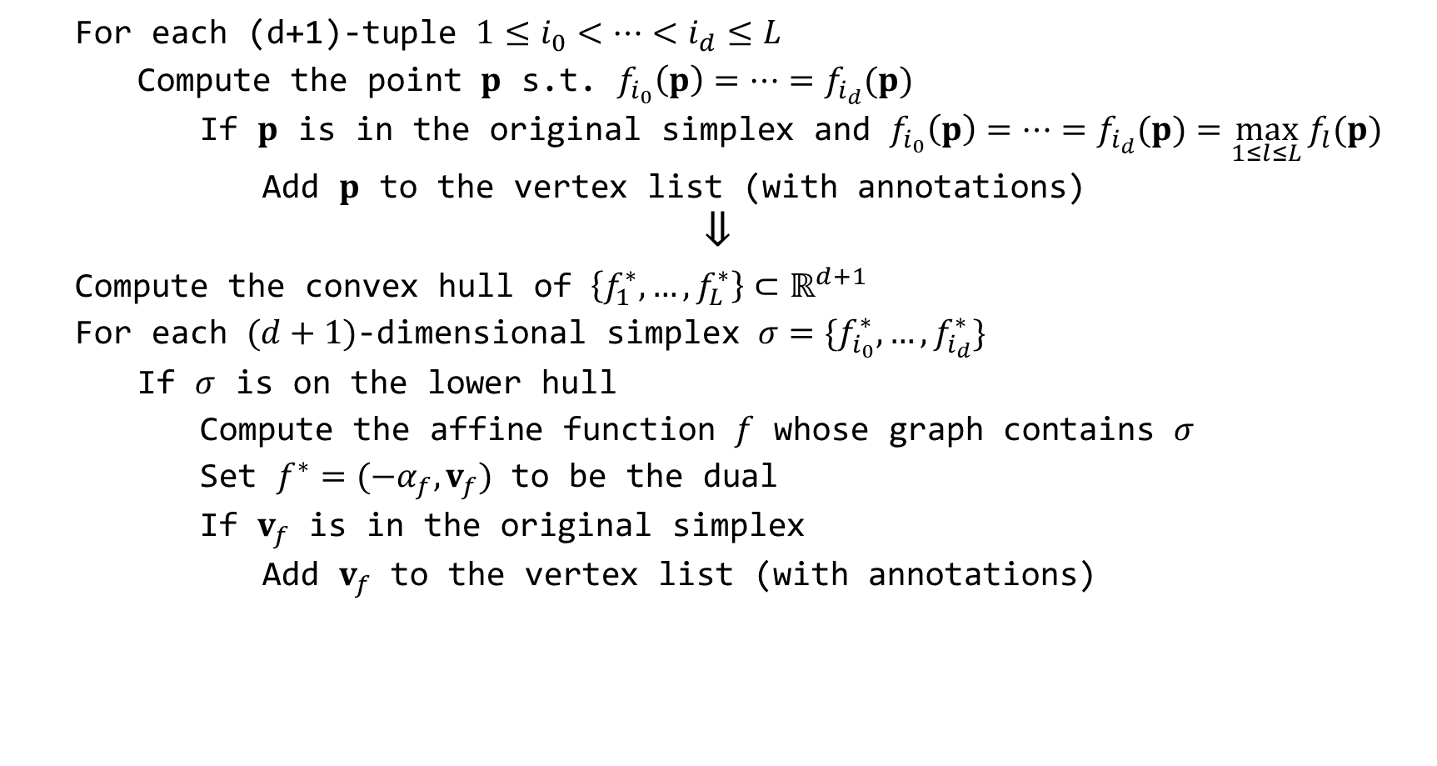
Faster multi-label segmentation (version 1)
For each (d+1)-tuple $1≤i_{0}<⋯<i_{d}≤L$
Compute the point $p$ s.t. $f_{i_{0}}\left(p\right)=⋯=f_{i_{d}}(p)$
If $p$ is in the original simplex and $f_{i_{0}}\left(p\right)=⋯=f_{i_{d}}(p)=\max_{1≤l≤L}{f_{l}(p)}$
Add $p$ to the vertex list (with annotations)
$$⇓$$
Compute the convex hull of $\left\{f_{1}^{∗},…,f_{L}^{∗}\right\}⊂ℝ^{d+1}$
For each $(d+1)$-dimensional simplex $σ=\{f_{i_{0}}^{∗},…,f_{i_{d}}^{∗}\}$
If $σ$ is on the lower hull
Compute the affine function $f$ whose graph contains $σ$
Set $f^{∗}=(−α_{f},v_{f})$ to be the dual
If $v_{f}$ is in the original simplex
Add $v_{f}$ to the vertex list (with annotations)

Slide 25
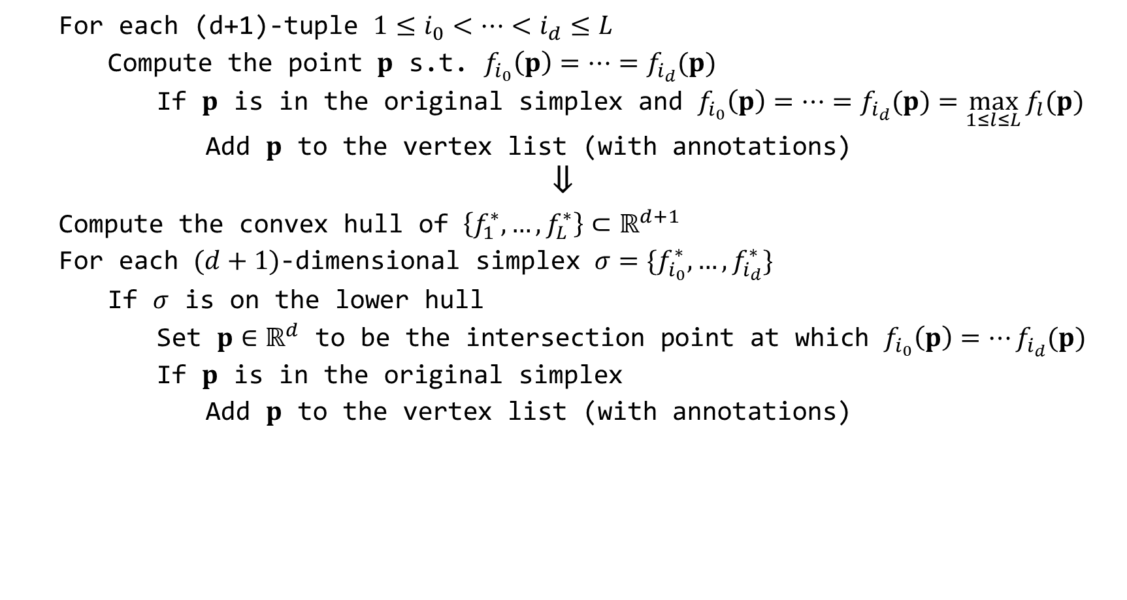
Faster multi-label segmentation (version 2)
For each (d+1)-tuple $1≤i_{0}<⋯<i_{d}≤L$
Compute the point $p$ s.t. $f_{i_{0}}\left(p\right)=⋯=f_{i_{d}}(p)$
If $p$ is in the original simplex and $f_{i_{0}}\left(p\right)=⋯=f_{i_{d}}(p)=\max_{1≤l≤L}{f_{l}(p)}$
Add $p$ to the vertex list (with annotations)
$$⇓$$
Compute the convex hull of $\left\{f_{1}^{∗},…,f_{L}^{∗}\right\}⊂ℝ^{d+1}$
For each $(d+1)$-dimensional simplex $σ=\{f_{i_{0}}^{∗},…,f_{i_{d}}^{∗}\}$
If $σ$ is on the lower hull
Set $p∈ℝ^{d}$ to be the intersection point at which $f_{i_{0}}\left(p\right)=⋯f_{i_{d}}(p)$
If $p$ is in the original simplex
Add $p$ to the vertex list (with annotations)

